Slide 1



Sales 360
View in Power BI
Last data refresh:
4/1/2025 10:57:20 AM UTC
Downloaded at:
4/1/2025 12:06:48 PM UTC

Slide 2
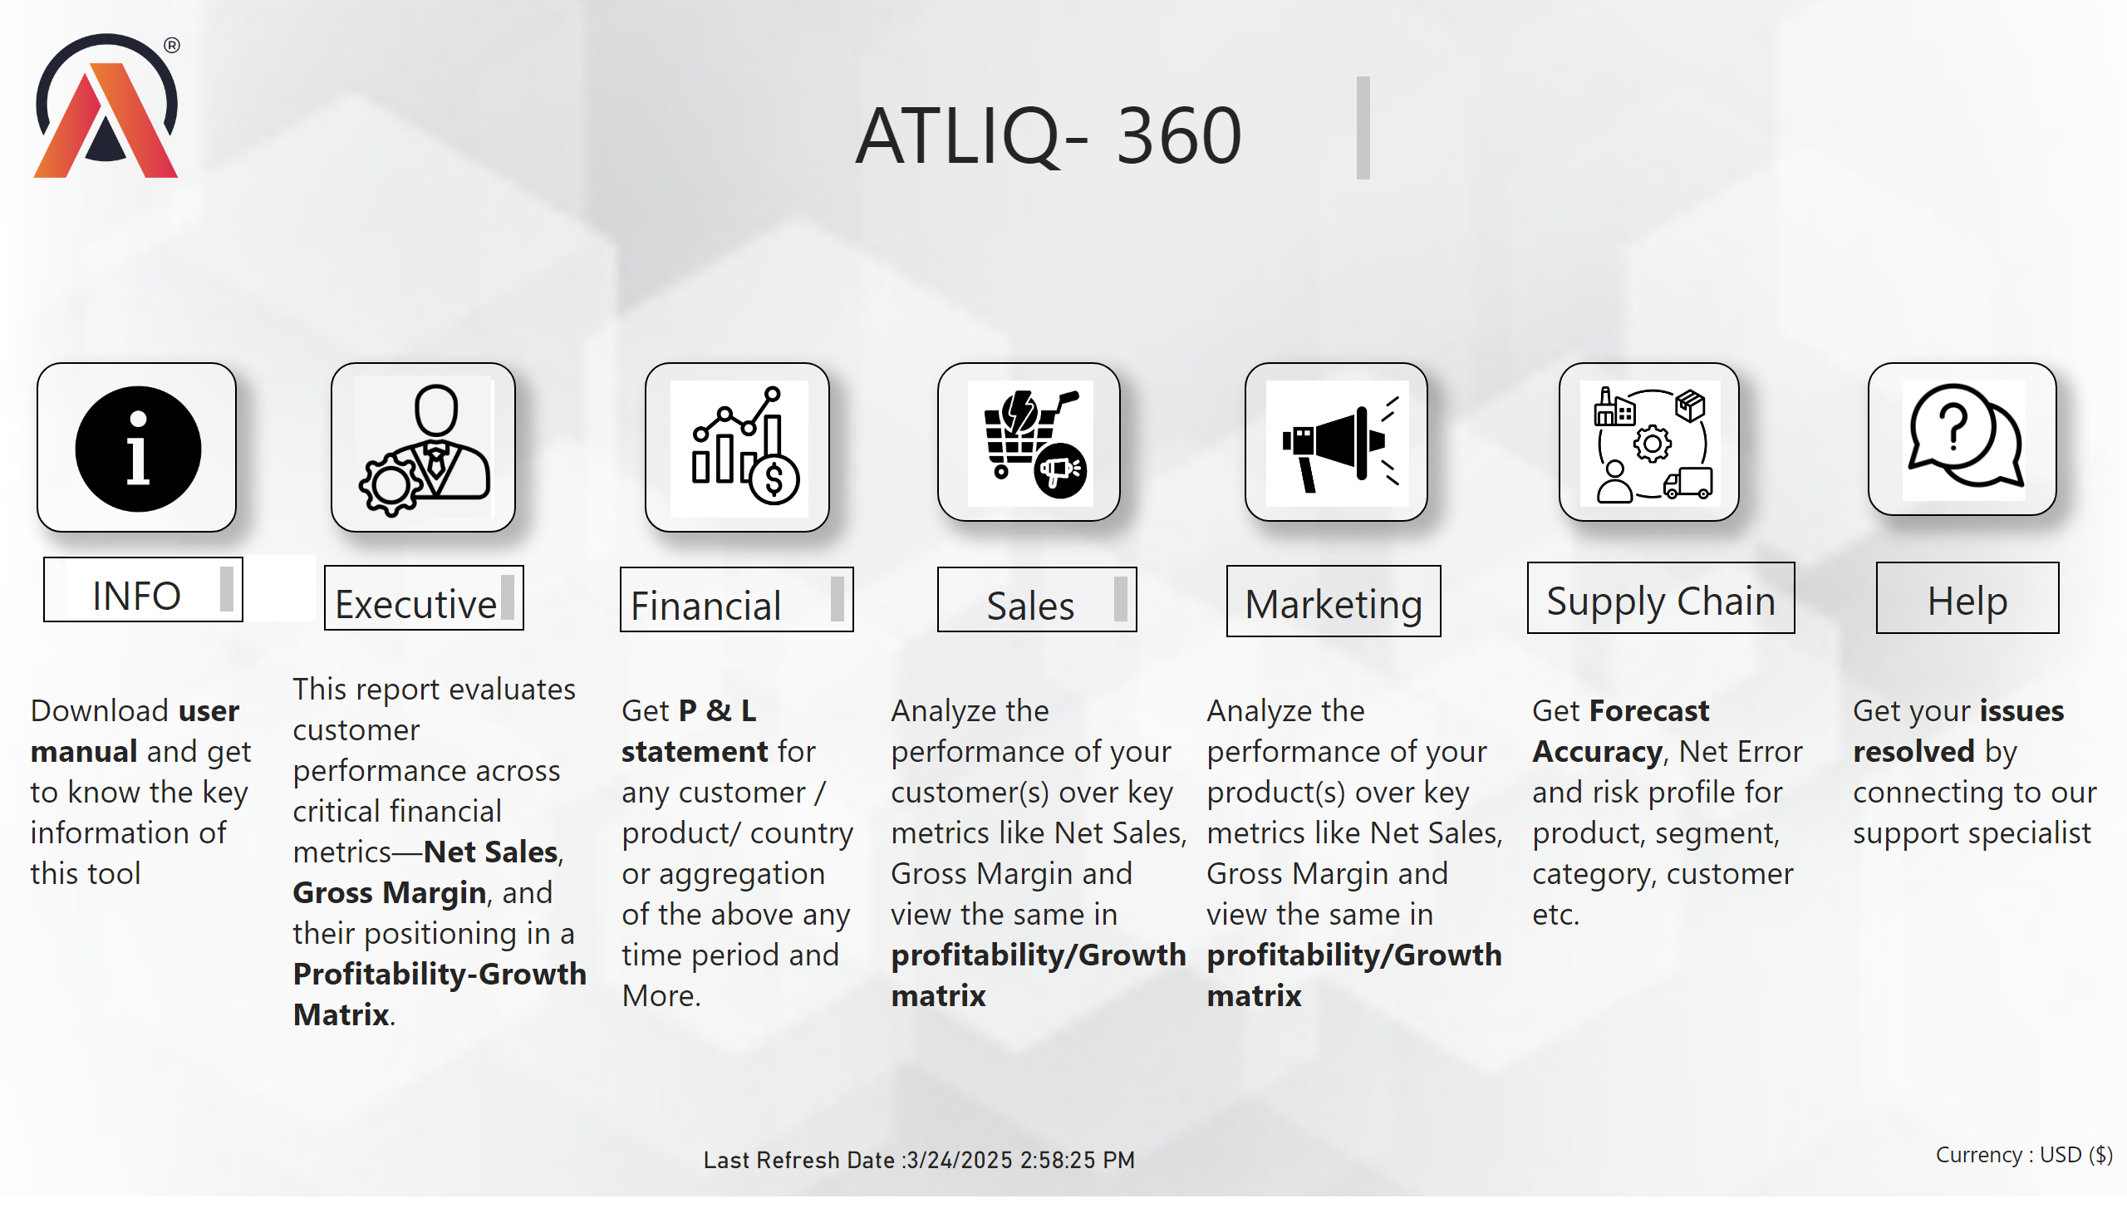
Home Page
Notes:
image
No alt text provided
image
No alt text provided
image
No alt text provided
image
No alt text provided
image
No alt text provided
image
No alt text provided
image
No alt text provided
textbox
No alt text provided
textbox
No alt text provided
textbox
No alt text provided
textbox
No alt text provided
textbox
No alt text provided
textbox
No alt text provided
textbox
No alt text provided
textbox
No alt text provided
textbox
No alt text provided
textbox
No alt text provided
textbox
No alt text provided
textbox
No alt text provided
textbox
No alt text provided
textbox
No alt text provided
card
No alt text provided
textbox
No alt text provided
image
No alt text provided
image
No alt text provided
textbox
No alt text provided
textbox
No alt text provided

Slide 3
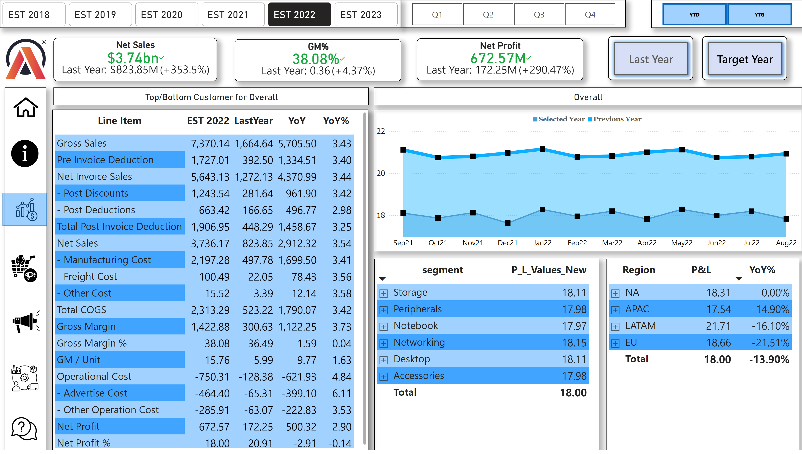
Page 8
Notes:
pivotTable
No alt text provided
advancedSlicerVisual
No alt text provided
slicer
No alt text provided
slicer
No alt text provided
Overall
No alt text provided
pivotTable
No alt text provided
pivotTable
No alt text provided
card
No alt text provided
card
No alt text provided
Net Sales
No alt text provided
GM%
No alt text provided
Net Profit
No alt text provided
image
No alt text provided
shape
No alt text provided
image
No alt text provided
image
No alt text provided
image
No alt text provided
image
No alt text provided
image
No alt text provided
image
No alt text provided
shape
No alt text provided
image
No alt text provided
actionButton
No alt text provided
actionButton
No alt text provided
kpi
No alt text provided
kpi
No alt text provided
kpi
No alt text provided
pivotTable
No alt text provided

Slide 4
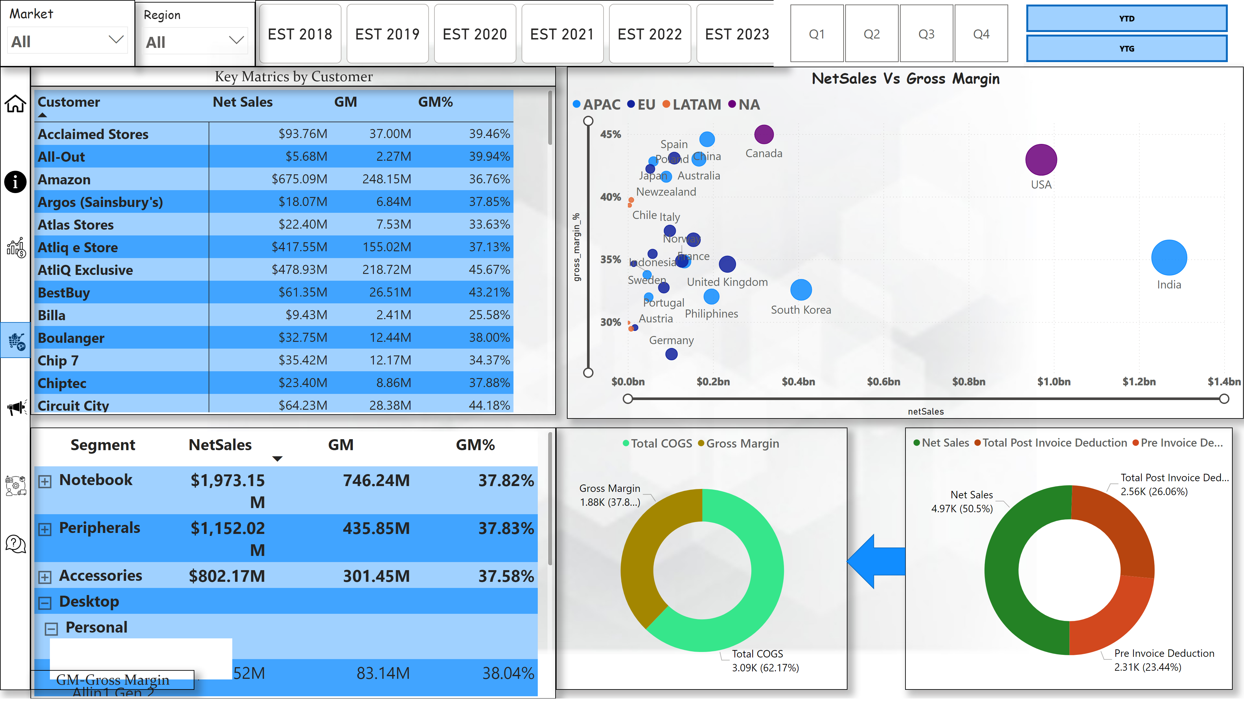
Sales View
Notes:
pivotTable
No alt text provided
NetSales Vs Gross Margin
No alt text provided
advancedSlicerVisual
No alt text provided
slicer
No alt text provided
slicer
No alt text provided
slicer
No alt text provided
slicer
No alt text provided
pivotTable
No alt text provided
donutChart
No alt text provided
donutChart
No alt text provided
shape
No alt text provided
textbox
No alt text provided
GM-Gross Margin
No alt text provided
Key Matrics by Customer
No alt text provided
shape
No alt text provided
image
No alt text provided
image
No alt text provided
image
No alt text provided
image
No alt text provided
image
No alt text provided
image
No alt text provided
shape
No alt text provided
image
No alt text provided

Slide 5
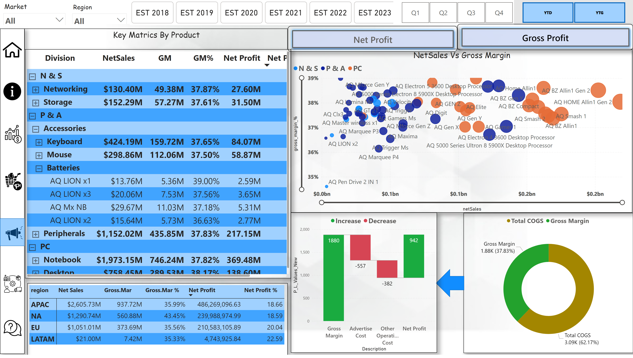
Marketing View2
Notes:
NetSales Vs Gross Margin
No alt text provided
advancedSlicerVisual
No alt text provided
slicer
No alt text provided
slicer
No alt text provided
slicer
No alt text provided
slicer
No alt text provided
pivotTable
No alt text provided
donutChart
No alt text provided
shape
No alt text provided
waterfallChart
No alt text provided
pivotTable
No alt text provided
Key Matrics By Product
No alt text provided
shape
No alt text provided
image
No alt text provided
image
No alt text provided
image
No alt text provided
image
No alt text provided
image
No alt text provided
image
No alt text provided
shape
No alt text provided
image
No alt text provided
scatterChart
No alt text provided
actionButton
No alt text provided
actionButton
No alt text provided

Slide 6
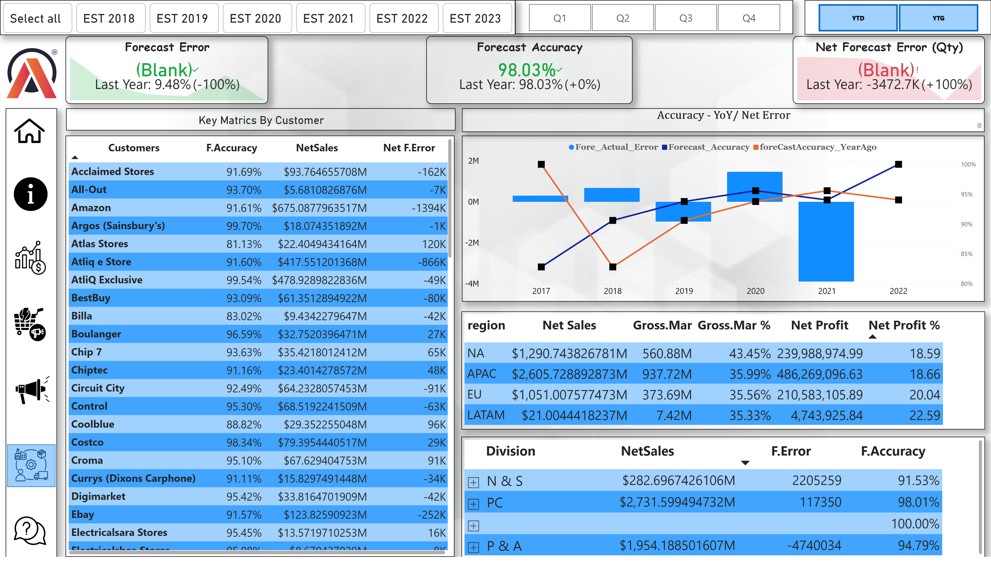
Supply_Chain
Notes:
advancedSlicerVisual
No alt text provided
slicer
No alt text provided
slicer
No alt text provided
card
No alt text provided
Forecast Error
No alt text provided
Forecast Accuracy
No alt text provided
Net Forecast Error (Qty)
No alt text provided
image
No alt text provided
shape
No alt text provided
image
No alt text provided
image
No alt text provided
image
No alt text provided
image
No alt text provided
image
No alt text provided
image
No alt text provided
shape
No alt text provided
pivotTable
No alt text provided
pivotTable
No alt text provided
pivotTable
No alt text provided
lineClusteredColumnComboChart
No alt text provided
Accuracy - YoY/ Net Error
No alt text provided
image
No alt text provided

Slide 7
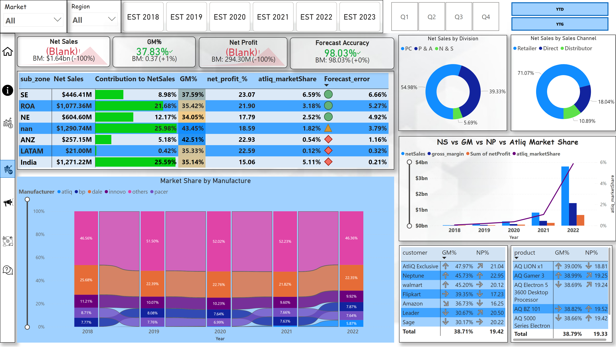
Executive View
Notes:
pivotTable
No alt text provided
NS vs GM vs NP vs Atliq Market Share
No alt text provided
advancedSlicerVisual
No alt text provided
slicer
No alt text provided
slicer
No alt text provided
slicer
No alt text provided
slicer
No alt text provided
shape
No alt text provided
image
No alt text provided
image
No alt text provided
image
No alt text provided
image
No alt text provided
image
No alt text provided
image
No alt text provided
shape
No alt text provided
image
No alt text provided
Net Sales
No alt text provided
GM%
No alt text provided
Net Profit
No alt text provided
Forecast Accuracy
No alt text provided
Net Sales by Division
No alt text provided
Net Sales by Sales Channel
No alt text provided
Market Share by Manufacture
No alt text provided
pivotTable
No alt text provided
pivotTable
No alt text provided

